Slide 1
Chapter 14
LINEAR REGRESSION

Slide 2
Simple Linear Regression
Predict an individual’s score on the DV from his or her score on one IV
Use data to produce an equation for a straight line
Use the line to make predictions about Y given a particular score on X

Slide 3
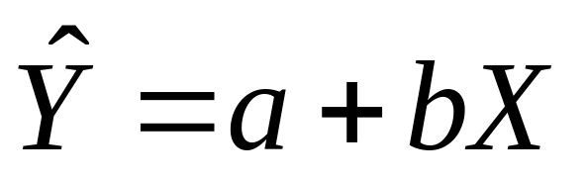
Regression Equation
a is the intercept (point at which the line crosses the y-axis)
b is the slope (amount that Y is predicted to increase for an increase of 1 in X)

Slide 4
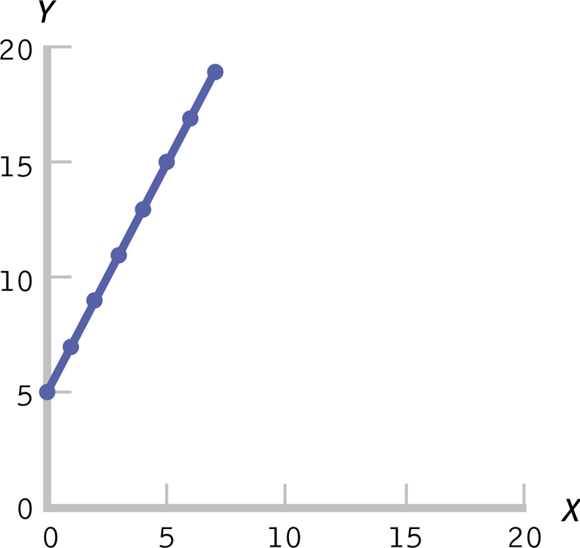
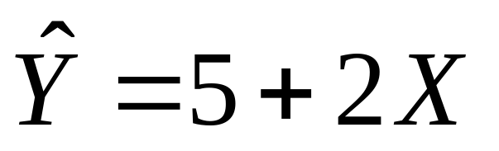
Example

Slide 5
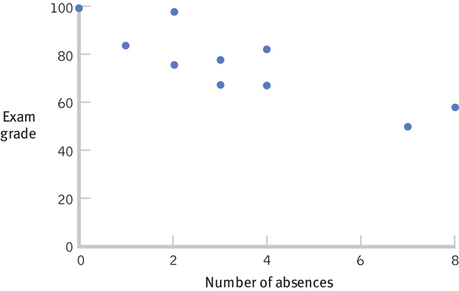
# Classes Missed & Exam Grade
r = -.85
M_{absences} = 3.40; SD_{absences} = 2.38
M_{exam} = 76; SD_{exam} = 15.04

Slide 6
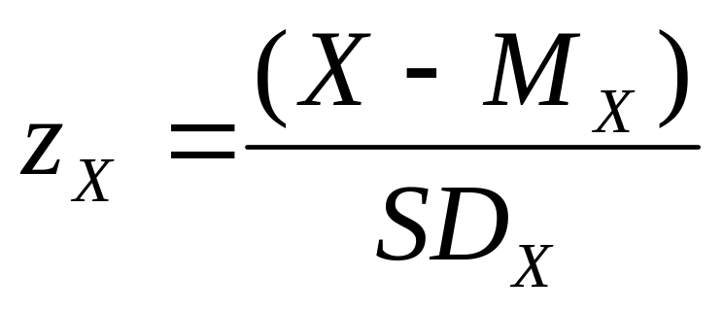
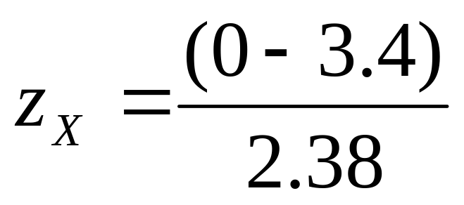
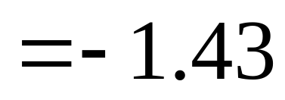
Step 1: Calculate a
Find the z score for X = 0

Slide 7
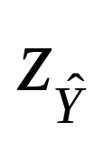
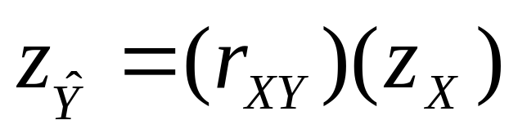
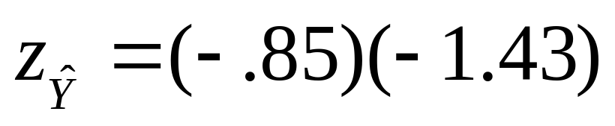
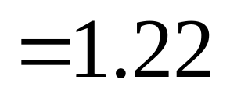
Step 1: Calculate a
Use z_{X} to calculate
(standardized regression equation)

Slide 8

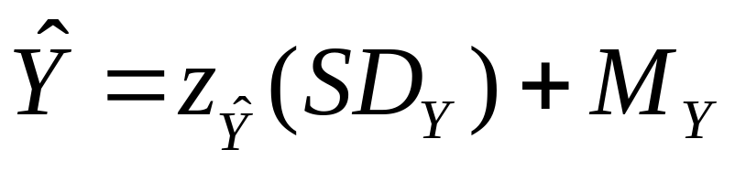
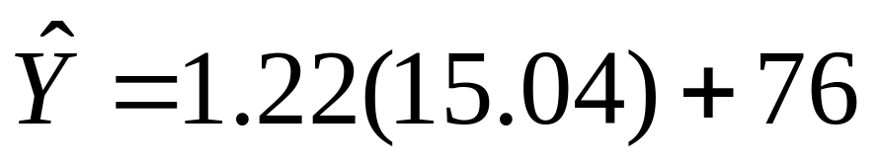
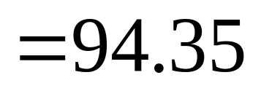
Step 1: Calculate a
Convert to

Slide 9
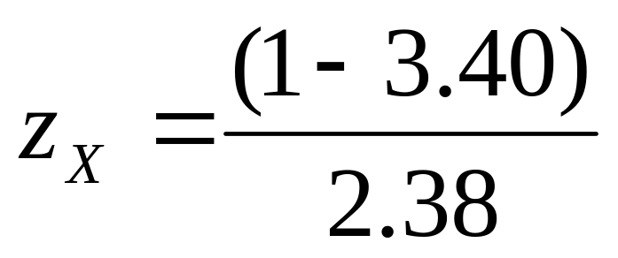
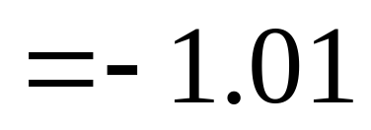
Step 2: Calculate b
Find the z score for X = 1

Slide 10
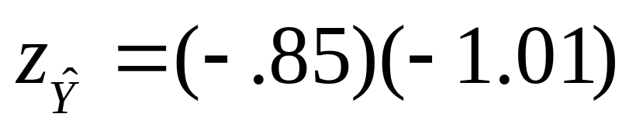
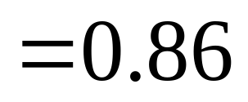
Step 2: Calculate b
Use z_{X} to calculate
(standardized regression equation)

Slide 11
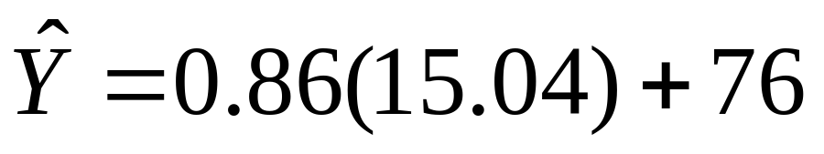
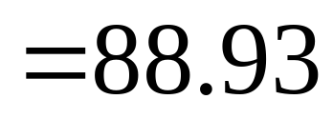
Step 2: Calculate b
Convert to

Slide 12
Step 2: Calculate b
(prediction) A student never misses class will earn a 94.35 (intercept)
(prediction) A student who misses 1 class will earn an 88.93
88.93 - 94.35 = - 5.42
Slope = - 5.42

Slide 13
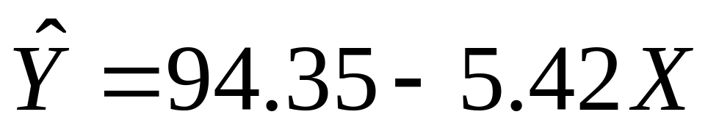
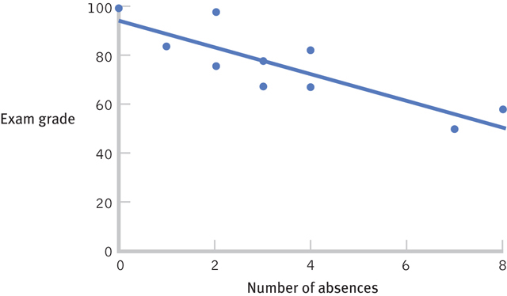
Regression Equation

Slide 14
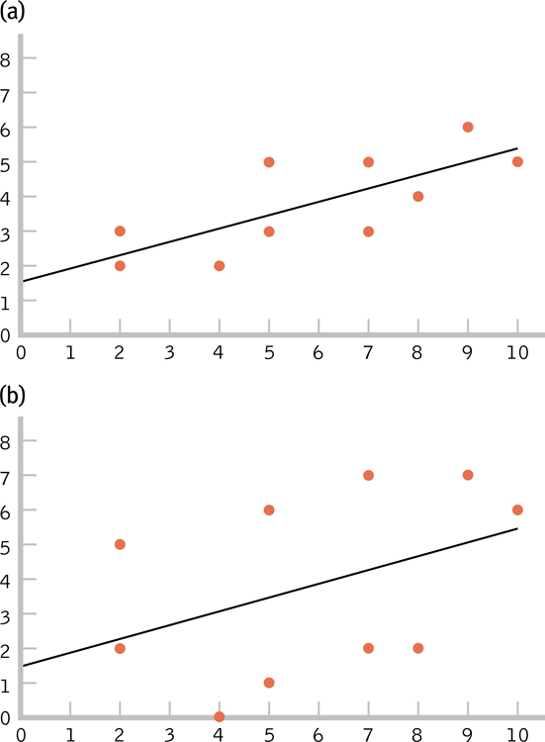
Standard Error of the Estimate
Indicates the typical
distance between a
regression line and the
actual data points

Slide 15
Proportionate Reduction in Error
aka: coefficient of determination
Quantifies how much more accurate predictions are when we use the regression line instead of the mean as a prediction tool

Slide 16
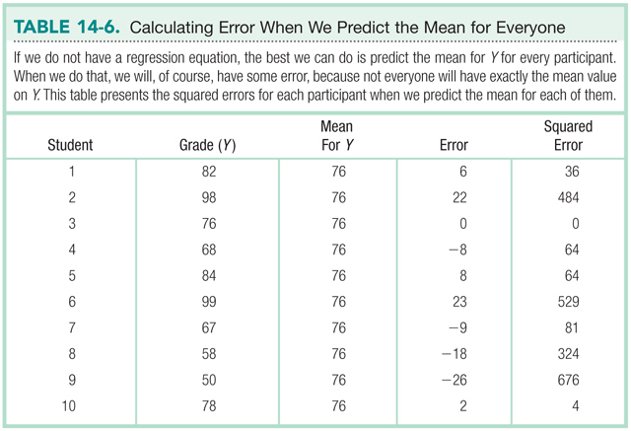
Proportionate Reduction in Error
Sum of Squared Errors = 2262

Slide 17
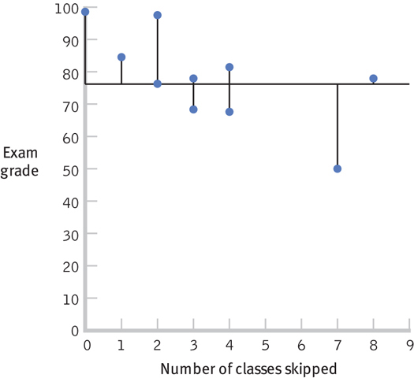
Proportionate Reduction in Error

Slide 18
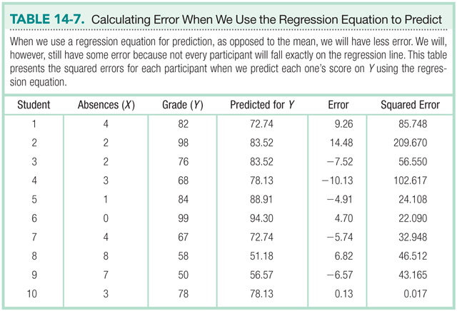
Proportionate Reduction in Error
Sum of Squared Errors = 623.42

Slide 19
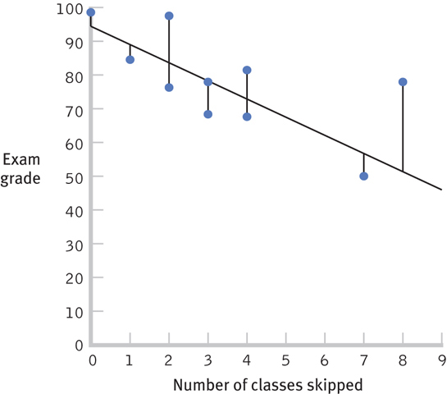
Proportionate Reduction in Error

Slide 20
Proportionate Reduction in Error
2262 – 623.42 = 1638.58
1638.58 / 2262 = 0.72
Error is reduced 72% by using the regression equation instead of the man to predict Y.

Slide 21
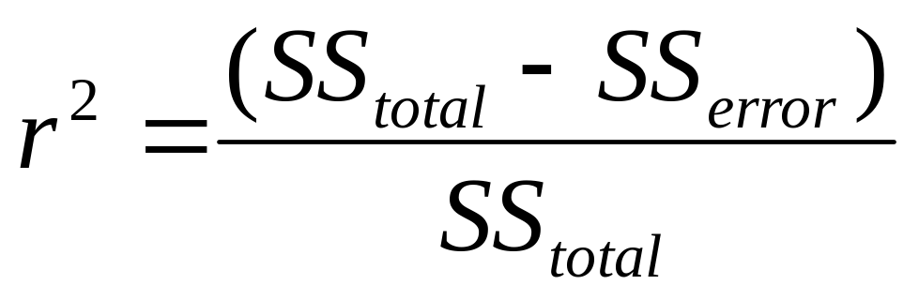
Proportionate Reduction in Error

Slide 22
Proportionate Reduction in Error
r²
r = -.85, r² = 0.72
72% of the variance in test scores is accounted for by number of absences.

Slide 23
Multiple Regression
Are multiple pieces of evidence better than one?
How much better is each additional piece of evidence?
Definition: A statistical technique that includes two or more predictor variables in a prediction equation

Slide 24
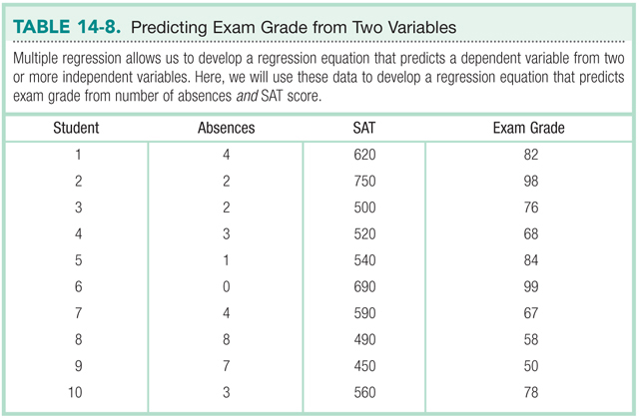
Multiple Regression

Slide 25
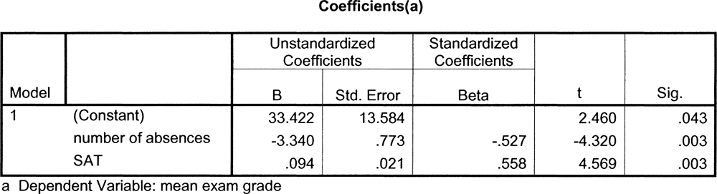
SPSS Output

Slide 26
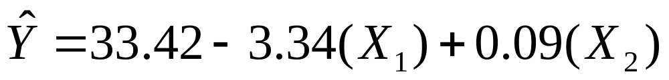
Multiple Regression Equation
What would you predict for Allie, who missed 2 classes and scored a 600 on the math portion of the SAT?

Slide 27
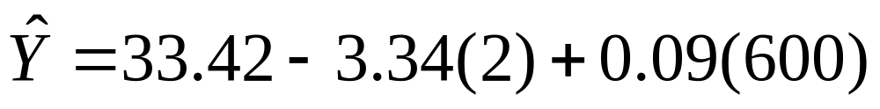
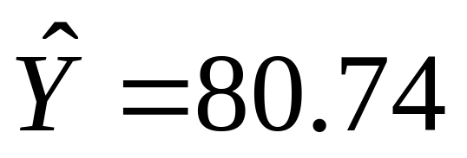
Example

